Slide 1

“SMART IRRIGATION SYSTEM” supervisior name: mr mayank pokrihyal PRESENTED BY : 1)ABHISHEK KUMAR SRIVASTAVA 2) ABHISHEK KUMAR SINGH 3) DURVESH SAHU

Slide 2
CONTENT
INTRODUCTION
NEED OF “AUTOMATIC IRRIGATION SYSYTEM”
EXISTING SYSTEM
MODIFICATION
METHODOLOGY
CONSTRUCTION & WORKING
ADVANTAGES & DISADVANTAGES
CONCLUSION

Slide 3
INTRODUCTION
Irrigation process can be used for the cultivation of agricultural crops during the span of inadequate rainfall and for maintaining landscapes
An automatic irrigation system does the operation of a system without requiring manual involvement of persons.
The System will consist a water pump which will be used to sprinkle water on the land depending upon the land environmental condition such as Moisture, Temperature and Humidity.

Slide 4
NEED?
INADEQUATE AMOUNT OF WATER SUPPLY TO THE FARMERS FROM PUMPS
BALANCED WATER SUPPLY TO THE CROPS
LESS MAN WORK
TO GET THE OUTPUT OF SOIL WATER SENSORS AND PROVIDE WATER TO CROP

Slide 5
EXISTING SYSTEMS…
Today in most of the rural area consists of system known of
“DRIP IRRIGATION”
It delivers water and nutrients directly to the plant’s roots zone, in the right amounts, at the right time, so each plant gets exactly what it needs, when it needs it, to grow optimally.
But at the same time it cannot deliver the proper nutirent to the soil.

Slide 6
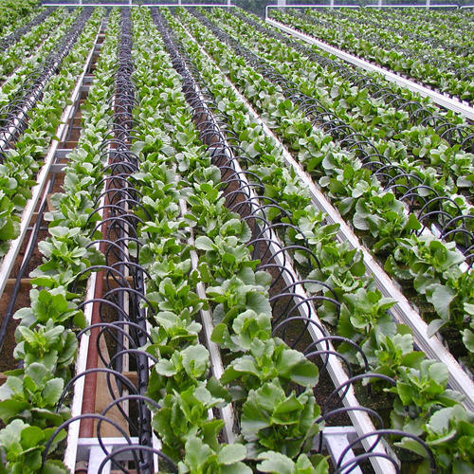
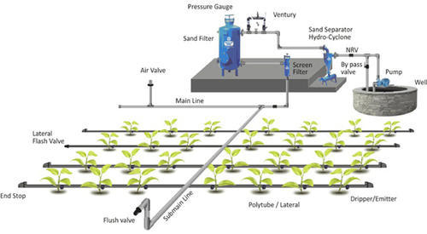
DRIP IRRIGATION SYSTEM

Slide 7
WHY TO CHANGE?
Major problem arises with “Drip Irrigation” is that doesn’t provide proper nutrient to the soil.
Drip irrigation emitters are vulnerable to clogging and dysfunction (water filters required, regular flushing of pipe system)
Soil salinity hazard.

Slide 8
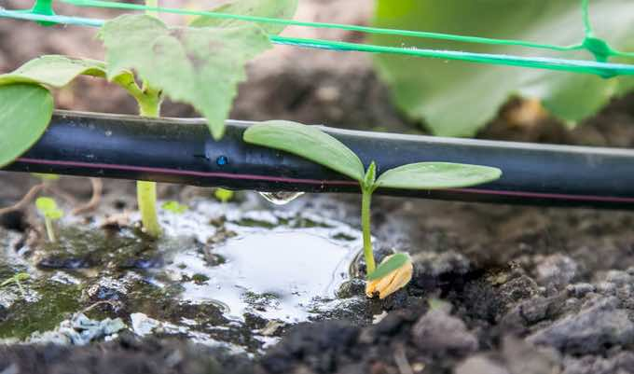
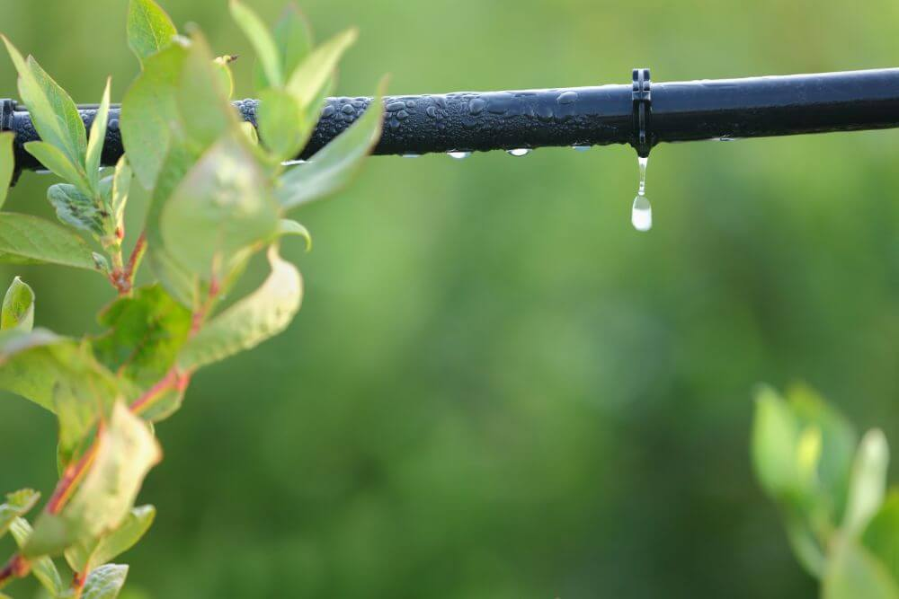
MAJOR PROBLEMS

Slide 9
MODIFICATION
A/C to the new technique there is a proper water supply & nutrient to the soil as well as to plants.
There is no further loss of excess amount of water.
Fixed amount of water supply to the crops.
Gathering of water doesn’t occurs.

Slide 10
CONSTRUCTION & WORKING

Slide 11
CONSTRUCTION…
DEVICES USED
Sprinkler ,Arduino UNO, Soil moisture sensor, Wi-Fi module ESP8266, Arduino ,CC(IDE), Android studio, and MySQL, etc.

Slide 12
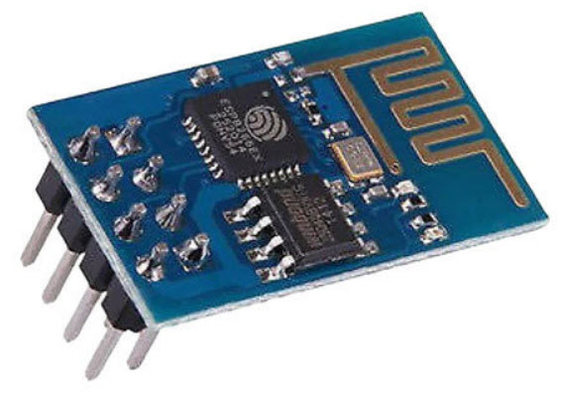
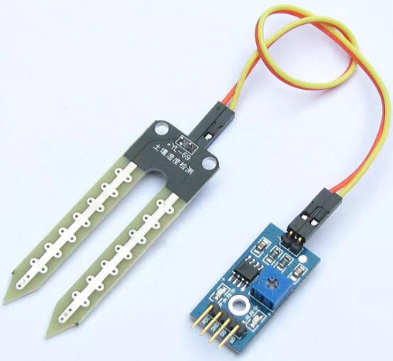
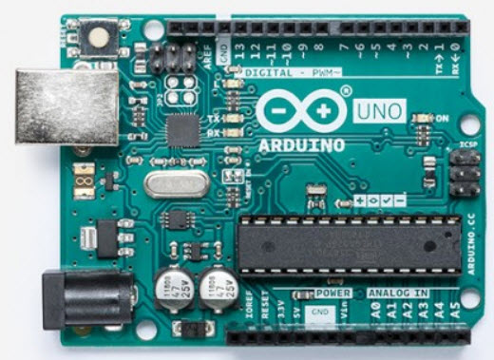
Soil moiSture sensor
Wifi module
ARDUINO BOARD

Slide 13
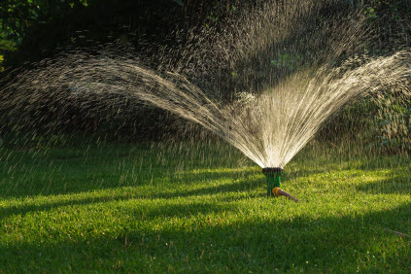
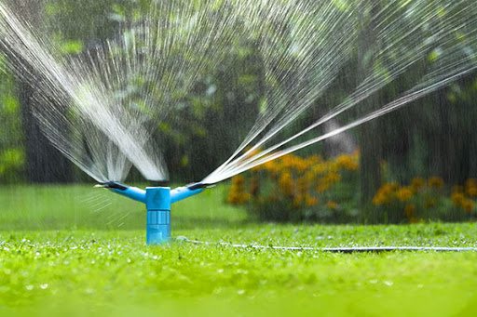
SPRINKLER’S

Slide 14
METHODOLOGY
1) Sensor and Data Acquisition : This stage consists of the moisture content sensor and the ultrasonic sensor as shown in Figure.
2) Control
3) Water Optimization

Slide 15
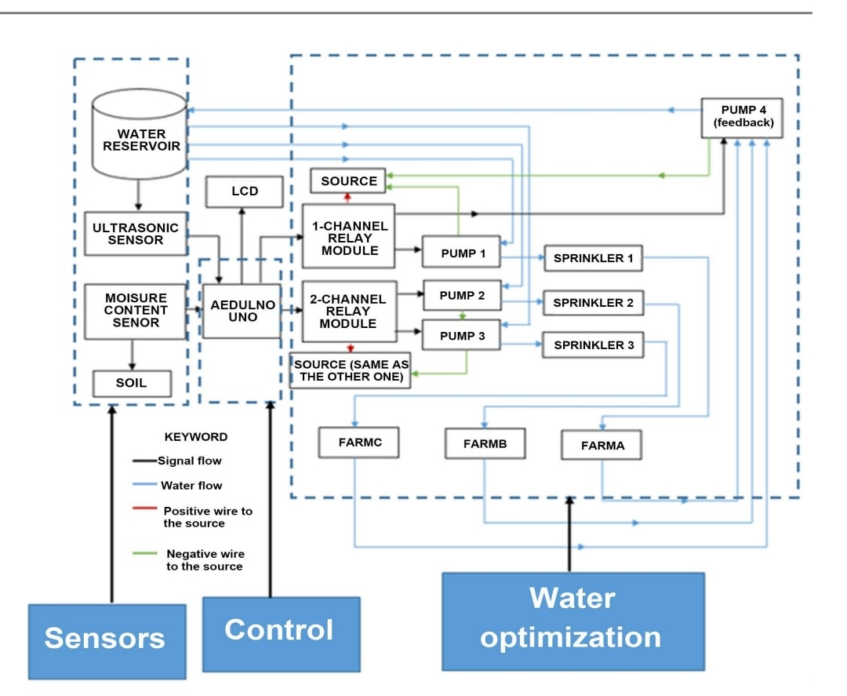

Slide 16
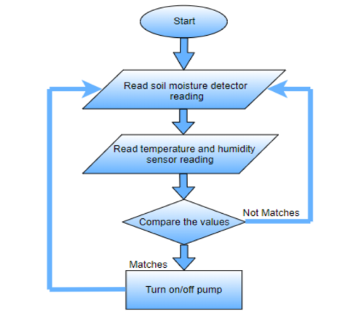
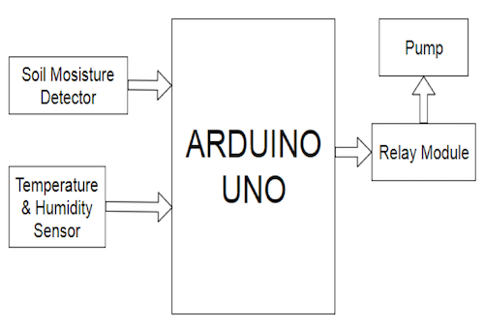
WORKING…
BLOCK DIAGRAM 1
BLOCK DIAGRAM 2

Slide 17
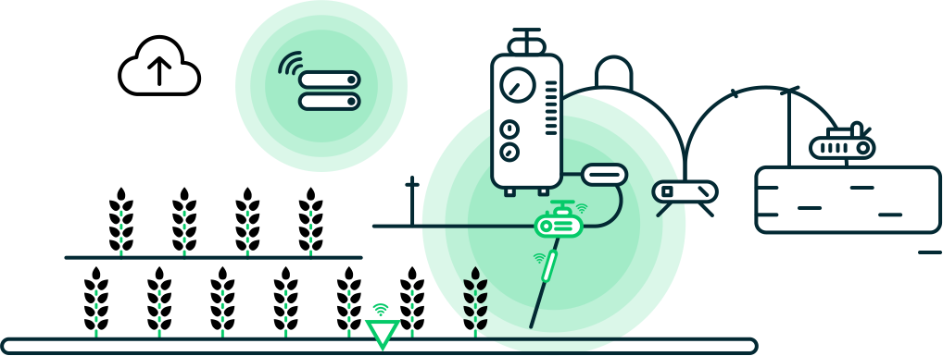
GROUND WORK DESIGN

Slide 18
ADVANTAGES & DISADVANTAGES
ADVANTAGES | DISADVANTAGES
LOW WATER LOSS (EFFICINENCY UP TO 80%) | INTIAL COST OF THE SETUP IS HIGH
SAVING IN FERTILIZER | 2) PEST PROBLEM
SUITABLE FOR ANY TOPOGRAPHY | 3) EFFICIENCY OF WATERING WILL DECREASE WITH STRONG WIND OR HIGH TEMP. CONDITION
NO SOIL EROSION
UNIFORM APPLICATION OF WATER

Slide 19
CONCLUSION
THE SMART IRRIGATION SYSTEM IS FEASIBLE & COST EFFECTIVE FOR OPTIMIZING WATER RESOURCES FOR AGRICULTURAL PRODUCTION
THE IRRIGATION SYSTEM ALLOWS CULTIVATION IN PLACES WITH WATER SCARCITY THERBY IMPROVING SUSTANABILITY
IT PROVES THAT THE EXCESS USE OF WATER CAN BE CONTROLLED.

Slide 20


